Slide 1
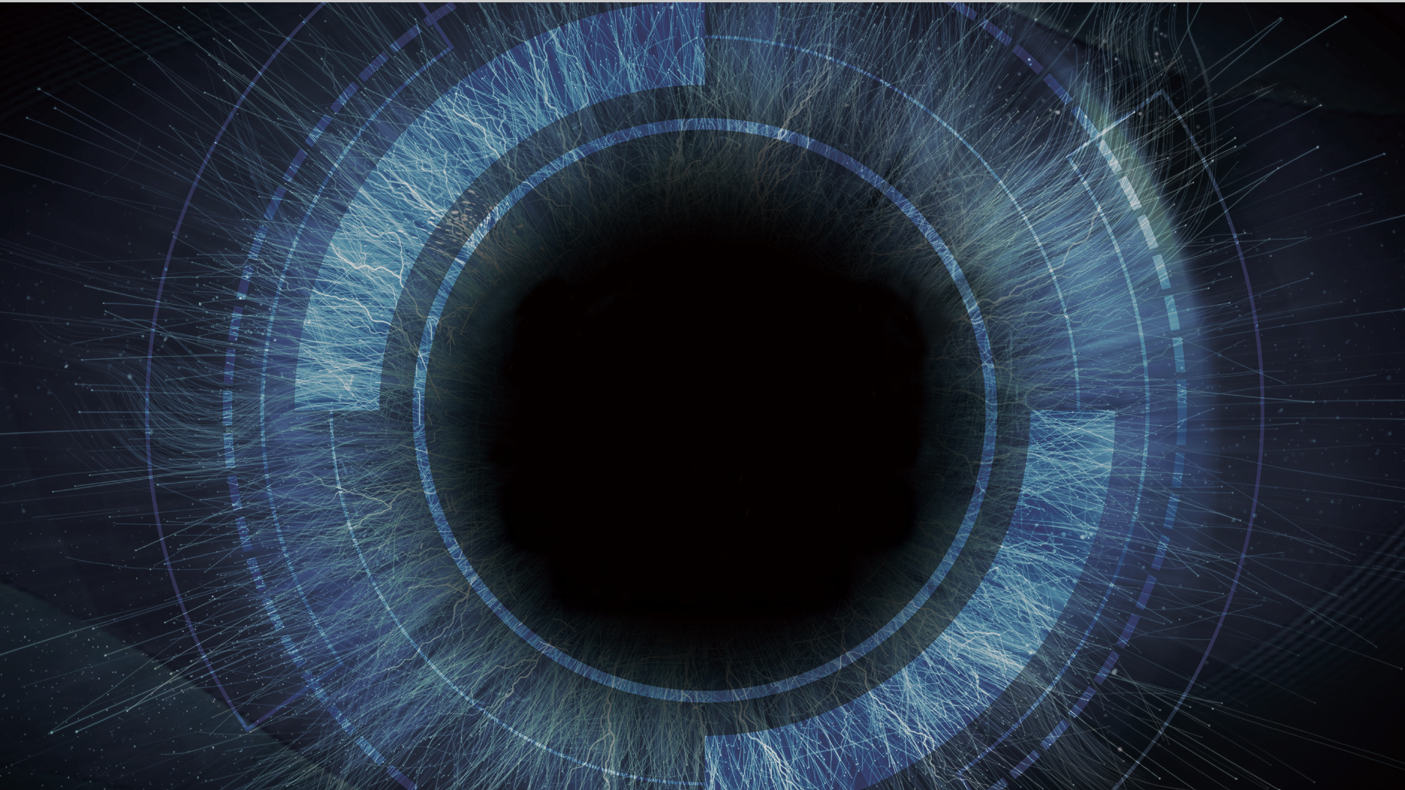
2025 NTU Computer Vision Final Project Iris Recognition Challenge
Ganzin Technology, Inc.
見臻科技

Slide 2
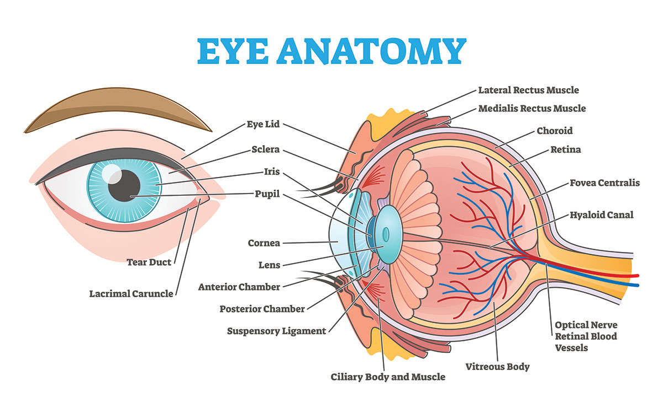
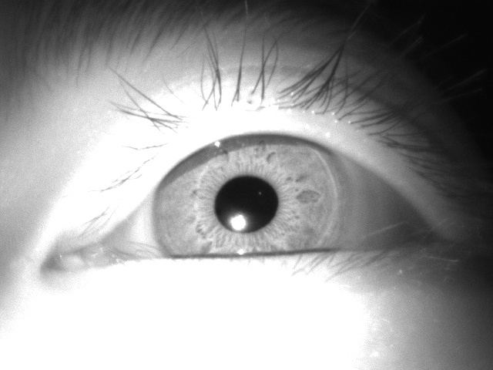
Human Eye Anatomy
Iris
Pupil

Slide 3
Iris Recognition
Unique: Iris variability among different people is enormous
Even from two eyes of the same person or eyes of twins
Large inter-class distance
Stable: Iris is stable over lifetime
Iris begins to form in the third month of gestation and the structures are largely complete by the eighth month
Small intra-class distance
Contactless: Easy to capture iris images
Iris recognition is more hygienic than biometrics that requires contact, such as fingerprint recognition.
Safe: Iris is well protected by eyelids and hard to forge

Slide 4
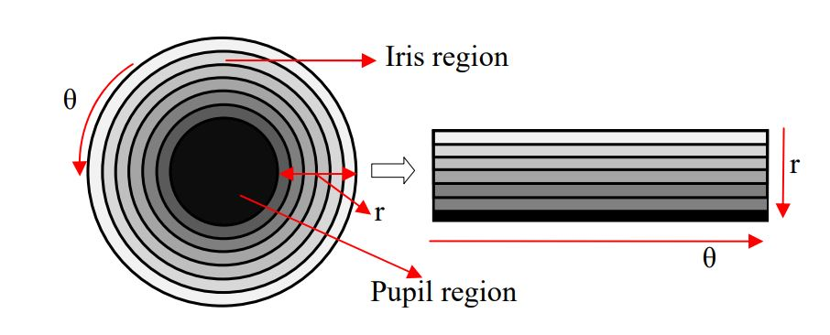
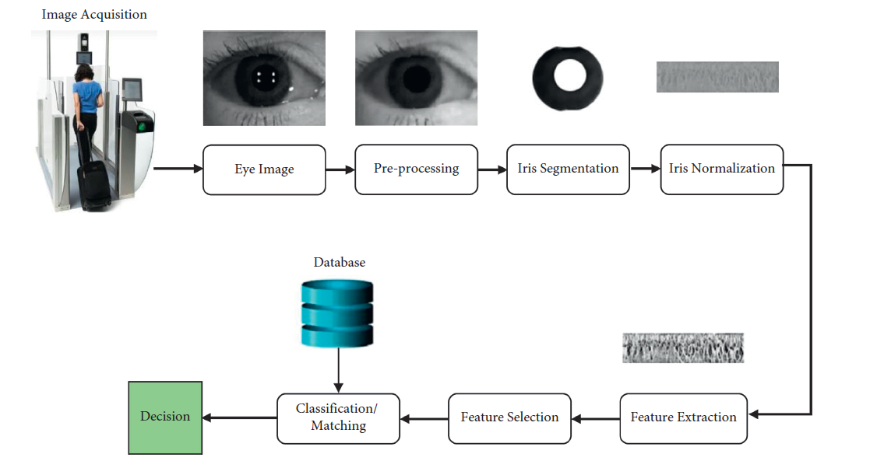
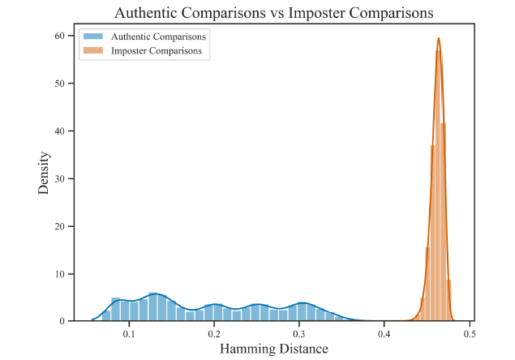
How Iris Recognition Works
Daugman’s rubber sheet model
Typical pipeline
An example of good feature selection

Slide 5
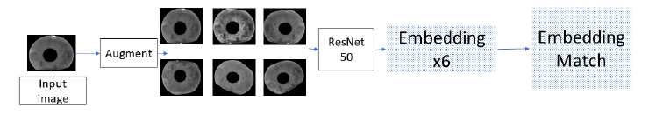
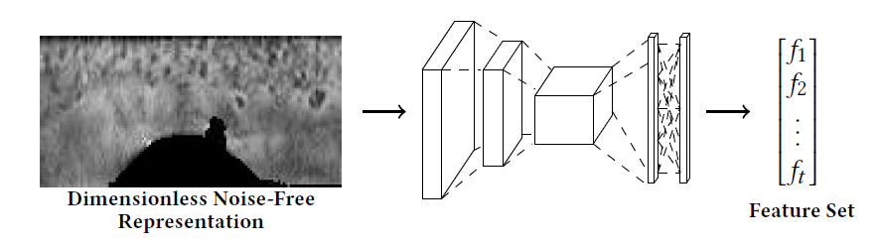
How Iris Recognition Works
Deep learning based methods
Input: iris ROI
Input: polar transformed iris

Slide 6
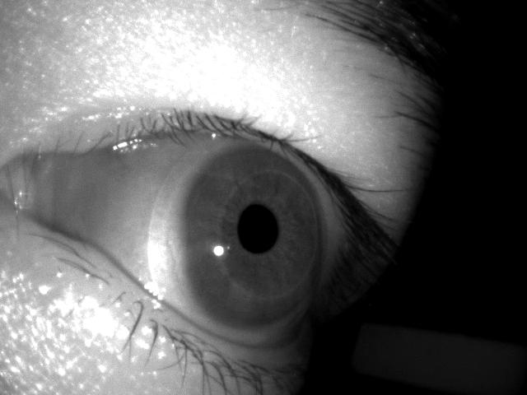
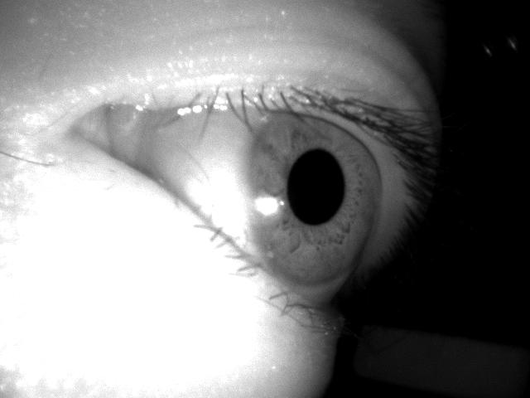
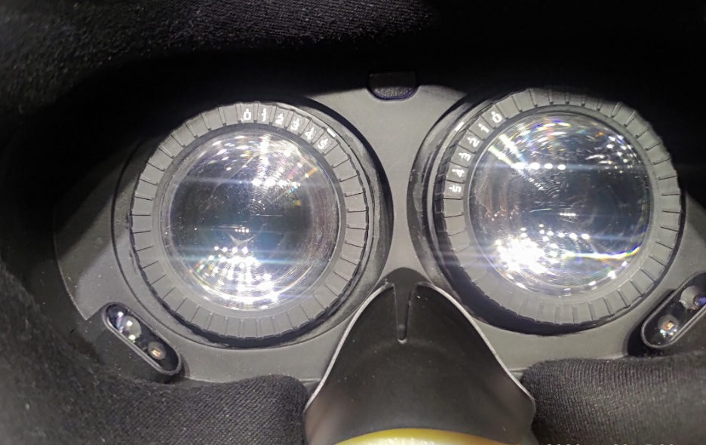
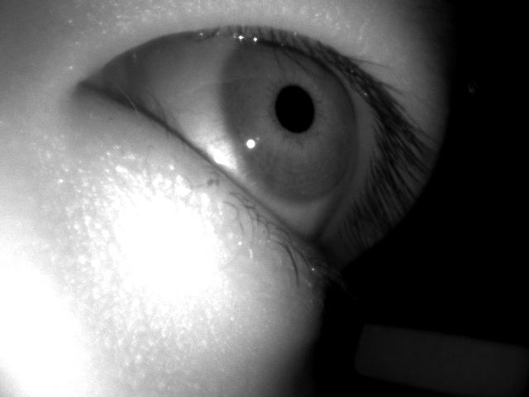
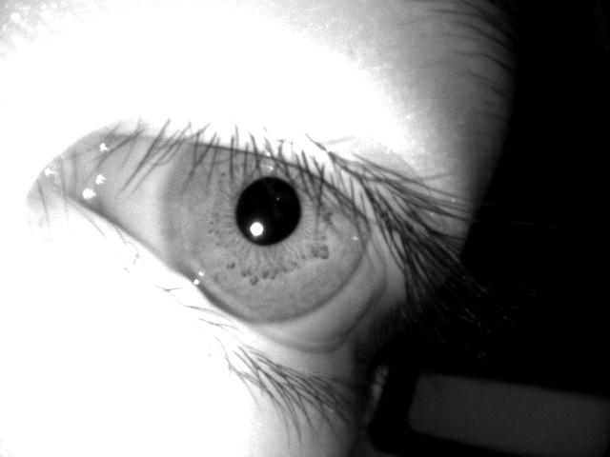
Challenges in AR/VR Devices
Eye camera has tilted viewing angle

Slide 7
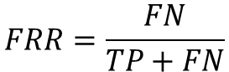
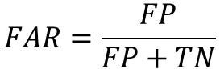
Common Evaluation Metrics
False acceptance rate (FAR)
False rejection rate (FRR)
$$FAR=\frac{FP}{FP+TN}$$
$$FRR=\frac{FN}{TP+FN}$$

Slide 8
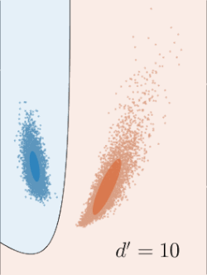
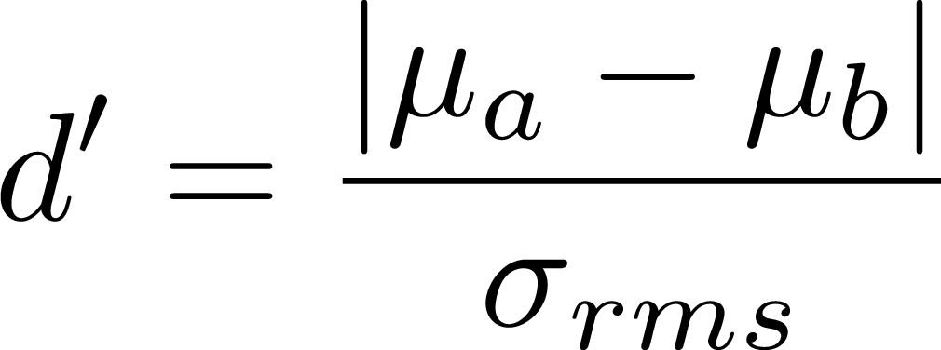
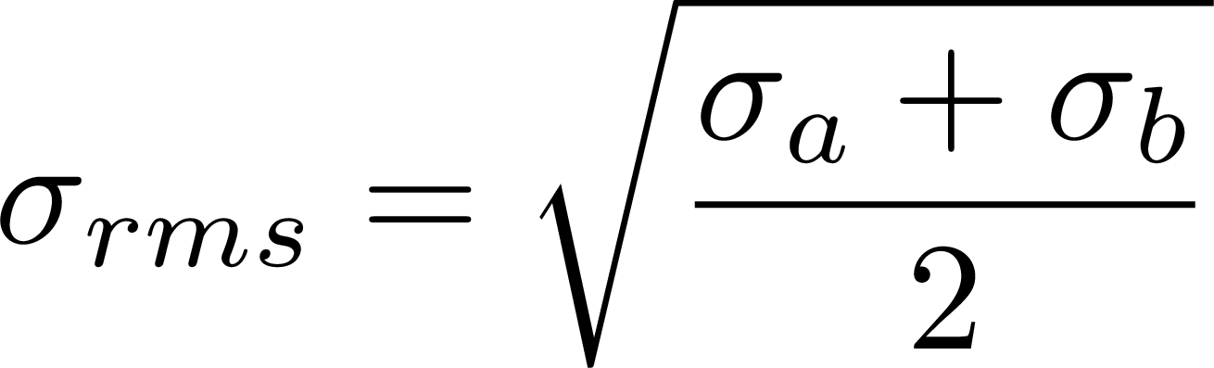
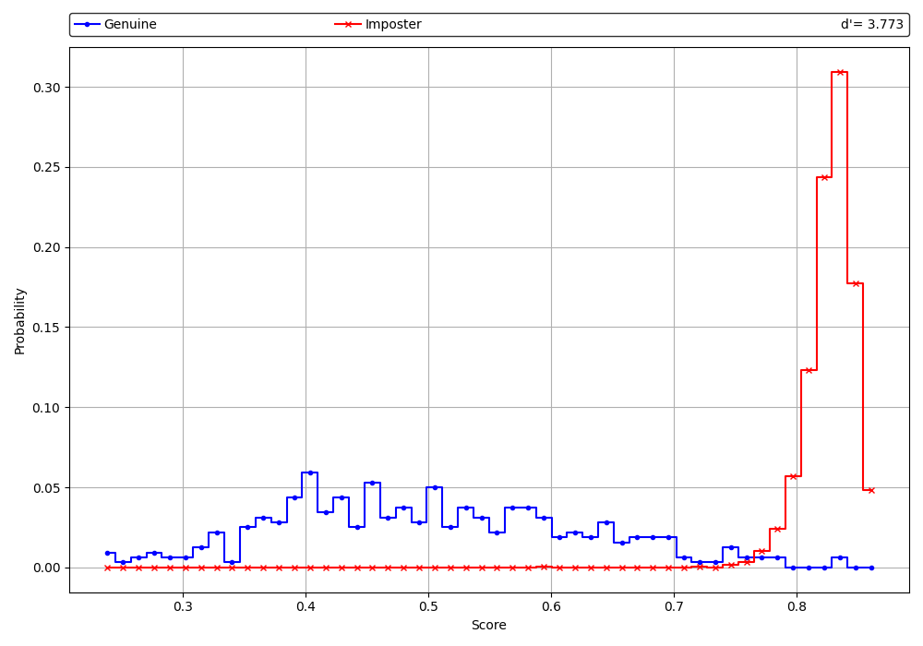
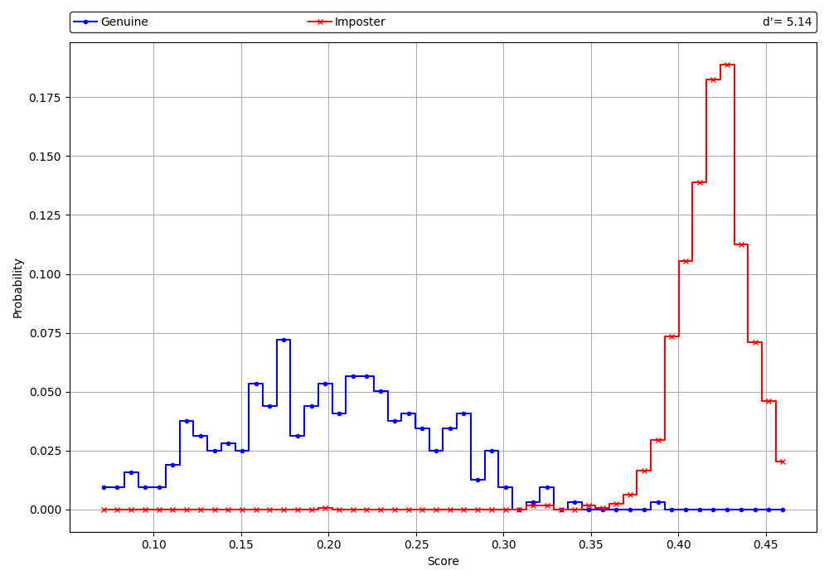
Common Evaluation Metrics
Discriminability index (d’ score)
See RMS sd discriminability index in wiki

Slide 9
Evaluation
Format: img1 path, img2 path, score
dataset/Ganzin-J7EF-Gaze/001/L/view_3_1.png, dataset/Ganzin-J7EF-Gaze/001/L/view_3_2.png, 0.013
dataset/Ganzin-J7EF-Gaze/001/L/view_3_1.png, dataset/Ganzin-J7EF-Gaze/001/L/view_3_3.png, 0.010
dataset/Ganzin-J7EF-Gaze/001/L/view_3_1.png, dataset/Ganzin-J7EF-Gaze/002/L/view_3_1.png, 0.996
dataset/Ganzin-J7EF-Gaze/001/L/view_3_1.png, dataset/Ganzin-J7EF-Gaze/003/L/view_3_1.png, 0.996
Evaluation protocol
eval.py
Described in a txt file
Sample image pairs from dataset
What ever the original output range is, normalize it to 0~1
Image 1
Your algorithm
Dissimilarity 0~1
0: genuine
1: imposter
Image 2
Compute d’ scores

Slide 10
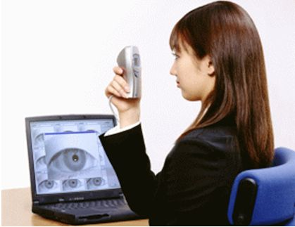
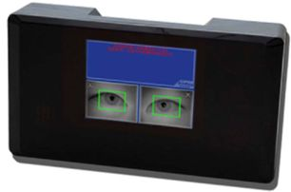
Dataset
CASIA-Iris-Thousand
20,000 NIR images of size 480x640 captured from 1,000 subjects
000~199 as test set
CASIA-Iris-Lamp
16,212 images of size 480x640 captured from 411 subjects
001~080 as test set
CASIA-Iris-Thousand images are collected with IKEMB-100 camera
CASIA-Iris-Lamp collection
Notes:
In practice, it is difficult to obtain ground truth pupils

Slide 11
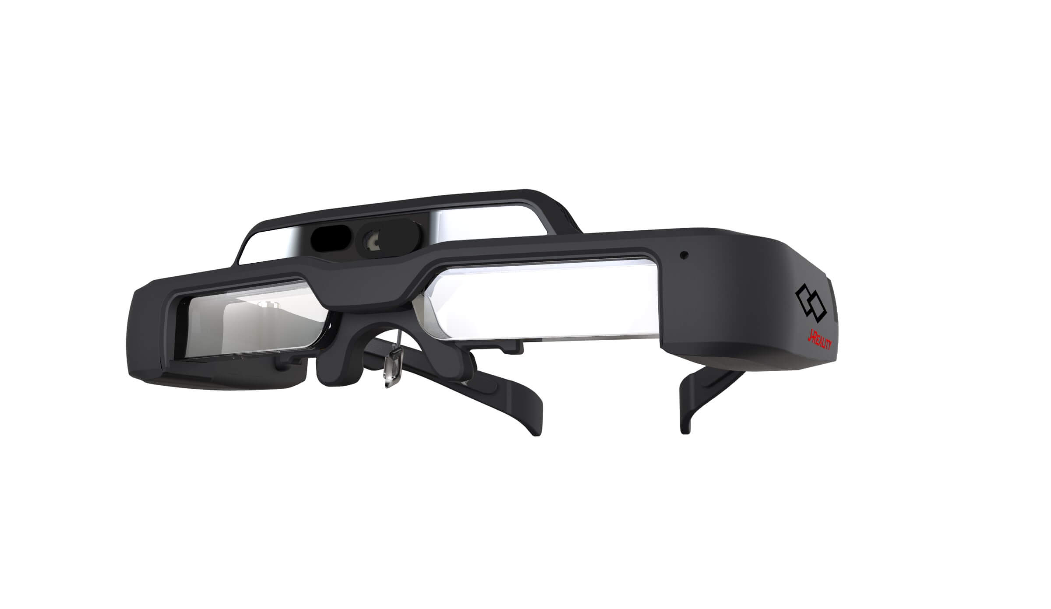
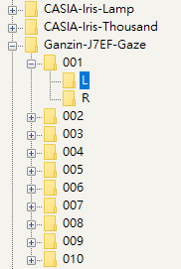
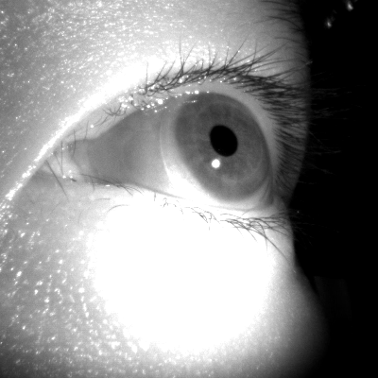
Dataset
Ganzin-J7EF-Gaze
Collected by J7EF-Gaze
10 subjects
Left/right eyes
5 eye directions
10 images per eye direction
10 * 2 * 5 * 10 = 1,000 images
Test set
Left eye viewing angle 3
Right eye viewing angle 2
view_1_1.png
First number: viewing angle index
Second number: image index
Notes:
In practice, it is difficult to obtain ground truth pupils

Slide 12
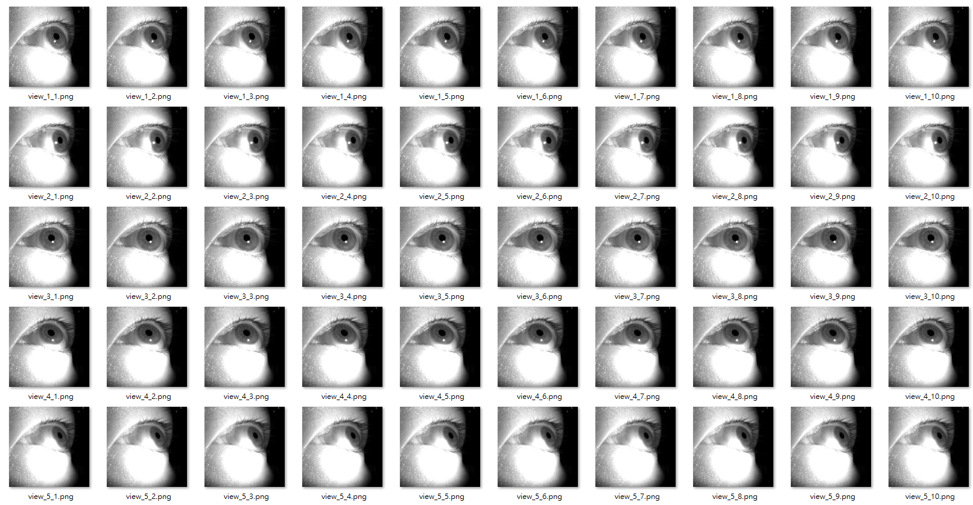
001 left eye

Slide 13
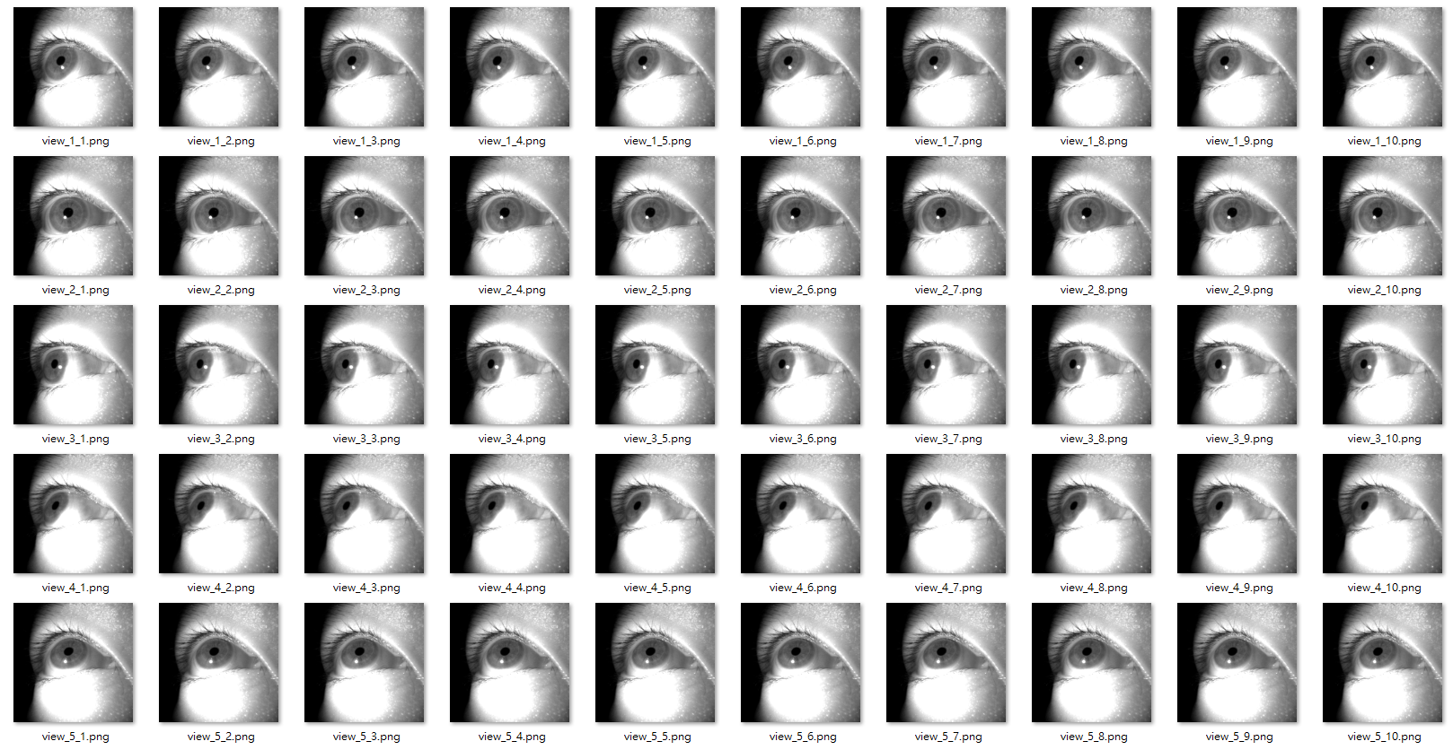
001 right eye

Slide 14
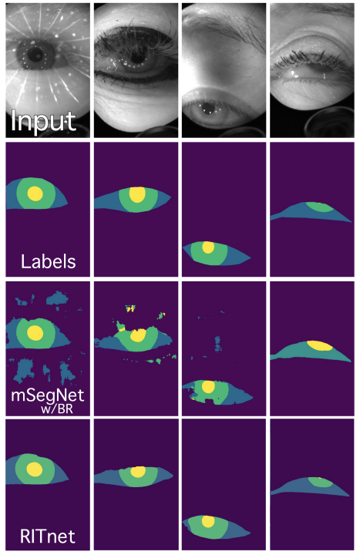
Iris Segmentation
You may use off-the-shelf models for segmentation
IrisParseNet
RITNet
EllSeg
etc.
Semantic segmentation by RITNet

Slide 15
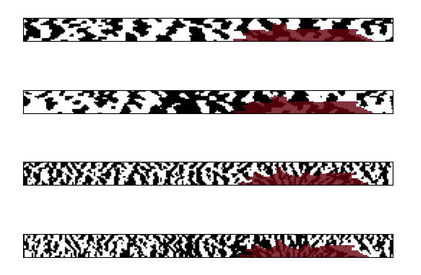
Open-source Iris Recognition Repositories
It is allowed to start with an open-source repositories
OpenSourceIrisRecognition
Open-IRIS
Dynamic graph representation for partially occluded biometrics (TPAMI 2023)
etc.
Visualization of iris codes computed by Open-IRIS

Slide 16
Other Requirements
Single algorithm for all datasets
You may have different models for different datasets
You may also tune parameters for different datasets

Slide 17
Scoring
Performance 60%
CASIA-Iris-Thousand (20%)
CASIA-Iris-Lamp (20%)
Ganzin-J7EF-Gaze
Left eye direction 3 (10%)
Right eye direction 2 (10%)
Report 40%
Bonus 10%
Ganzin-J7EF-Gaze
Cross angle matching

Slide 18
Reference
John Daugman. "How Iris Recognition Works." IEEE Transactions on Circuits and Systems for Video Technology 14.1 (2004): 21.
Jasem Rahman Malgheet, Noridayu Bt Manshor, and Lilly Suriani Affendey. "Iris recognition development techniques: a comprehensive review." Complexity 2021.1 (2021): 6641247.

